Slide 1
PUF Transformer
A transformer based modeling attack on Physical Unclonable Functions (PUF)
Rhodel R. Quizon

Slide 2
INTRODUCTION
01

Slide 3
Physical Unclonable Function (PUFs)
Physical Unclonable Functions or PUFs are one of the re- cent emerging protocols in cryptographic protocols for IoT authentication. It utilizes the manufacturing variations to receive different responses from devices of same designs.
It uses variability in production such as delays to receive different responses. These means that PUFs are designed so that two devices with similar designs will have different group of challenge response pairs.

Slide 4
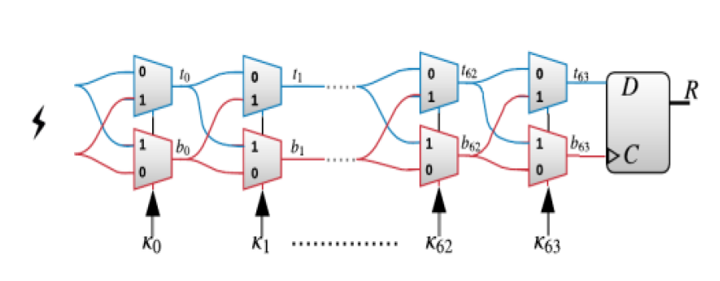
Arbiter PUFs

Slide 5
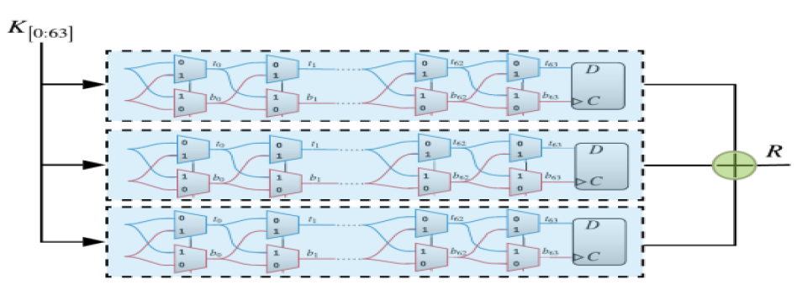
XOR Arbiter PUFs

Slide 6
Deep Learning
Artificial intelligence has been having significant progress
in the recent years. Deep learning has been used in solving
different problems such as object detection, natural language
processing, or image generation

Slide 7
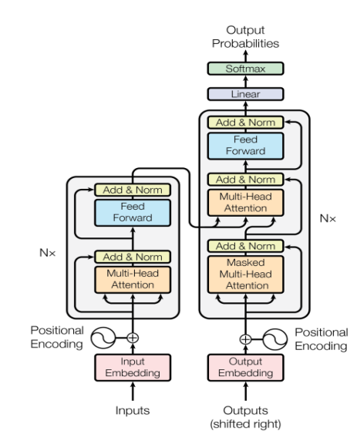
Original Transformer

Slide 8
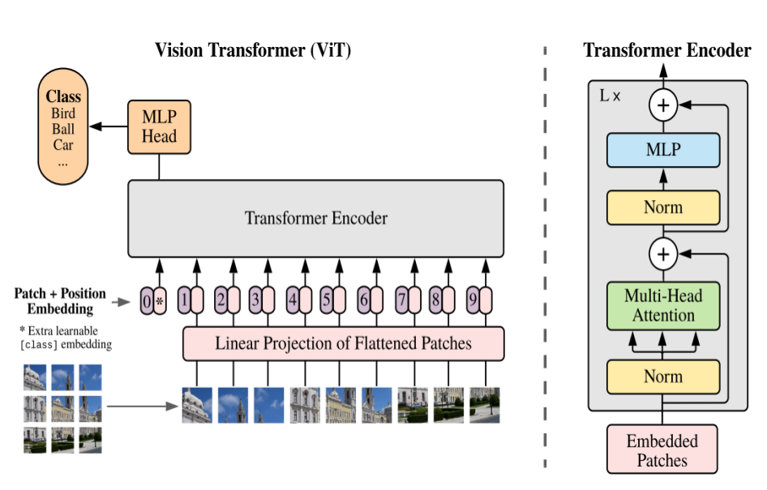
Vision Transformer

Slide 9
Related works
There have been recent studies exploring use of deep learning for attacking XOR Arbiter PUFs

Slide 10
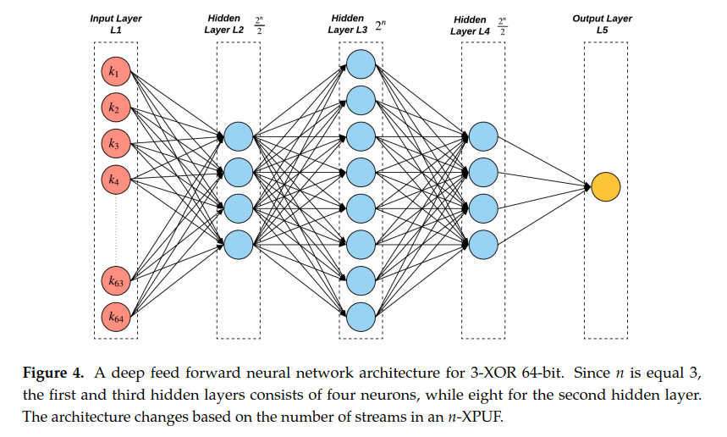
Mursi et al 2020
Used Silicon CRPs and Simulated CRPs
Used purely linear layers

Slide 11
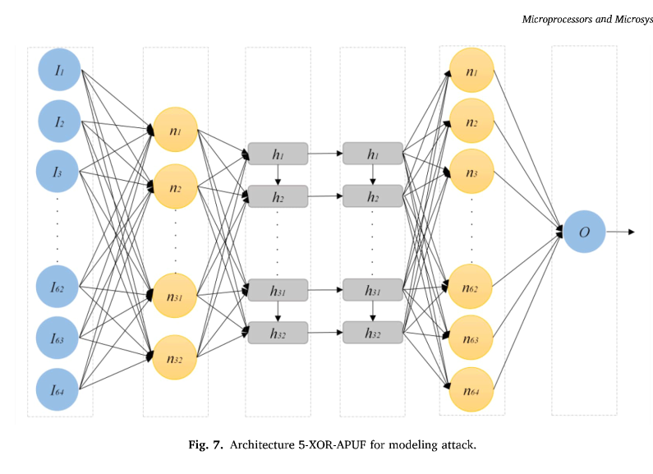
Fard et al 2022
Used simulated CRPs
Used linear layers and LSTM

Slide 12
Nils Wisiol et al, 2022
Evaluated several machine learning based attacks on PUFs
and try to replicate their results.
They used PYPUF, a CRP generator to test the machine learning based attacks.
One study evaluated in this paper is Mursi et. al’s study using linear layers

Slide 13
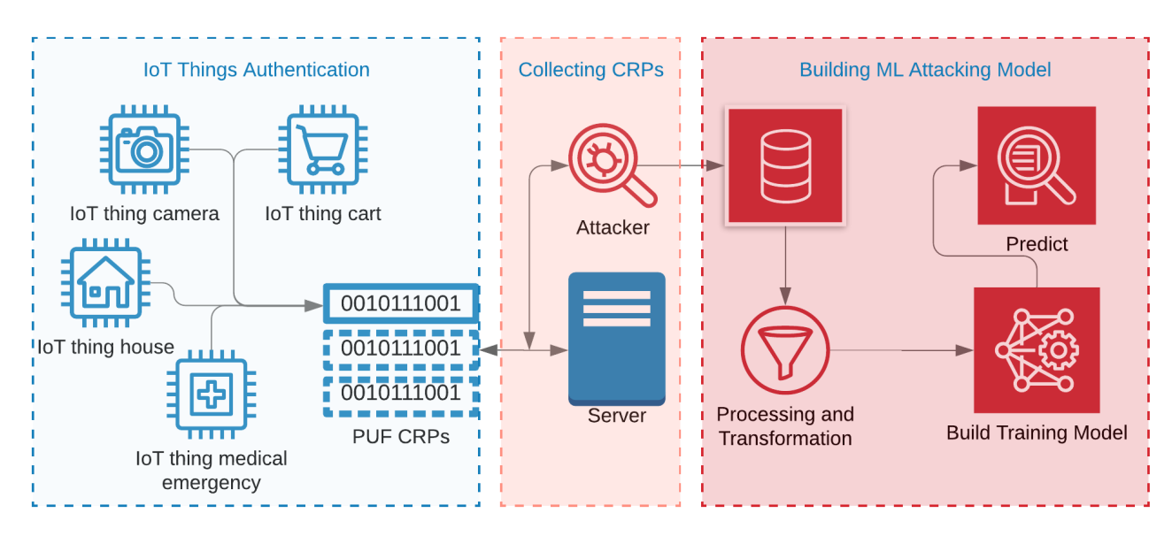
PUF hacking

Slide 14
METHODOLOGY
02

Slide 15
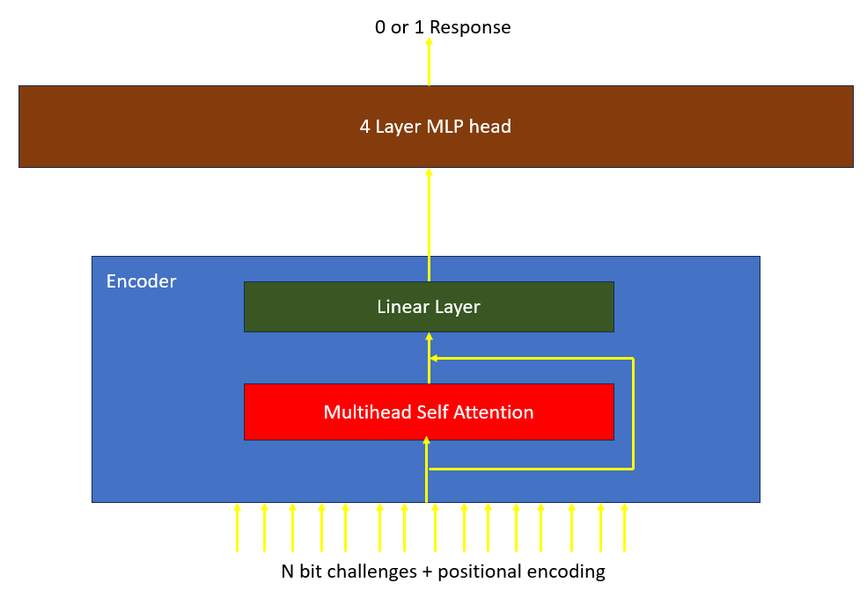

PROPOSED ARCHITECTURE FOR THIS STUDY
256
$pe\left[pos\right]=10000sin⁡(\frac{pos}{{10000}^{2}}$)
32

Slide 16
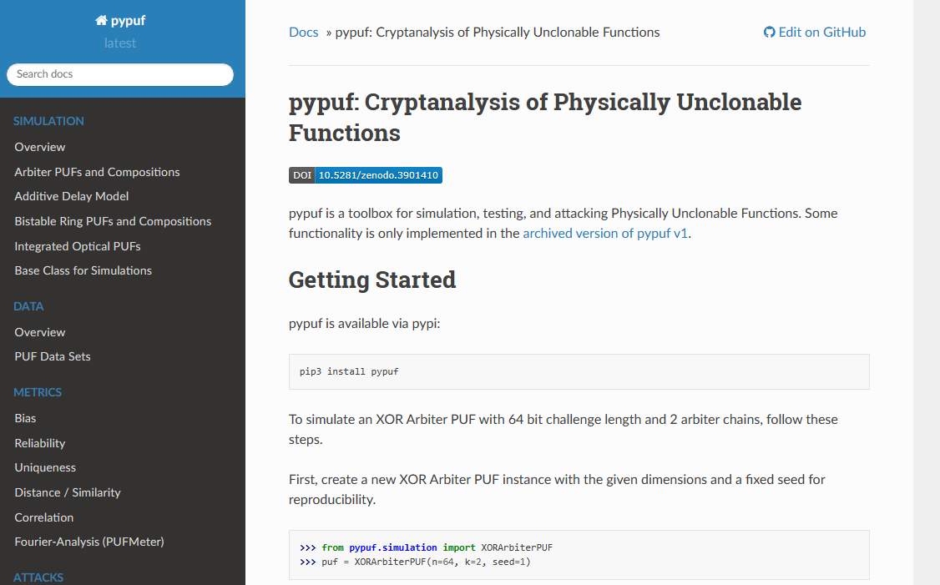
DATASET
PYPUF is used as simulator of PUFs for this study.
PYPUF is developed by Nils
Wisiol et. al. They used this
Simulator to replicate
results reported by different
machine learning studies
attacking XOR arbiter PUFs.

Slide 17
Parameters of the transformer attack method
Library | Pytorch
Method | Transformer Architecture
Architecture | One Layer Encoder+MLP head
Hidden Layer activation functions | Tanh
Output activation function | Sigmoid
Loss Function | BCE Loss
Learning Rate | 0.005/0.001 with Cosine Annealing
Optimizer | Adam
CRP Source | Synthetic
Dropout | 0.1/0.2
Number of heads | 8
Batch size | 10000

Slide 18
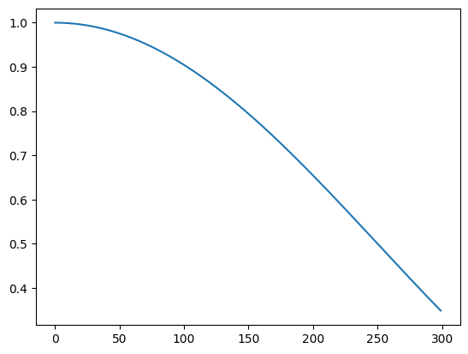
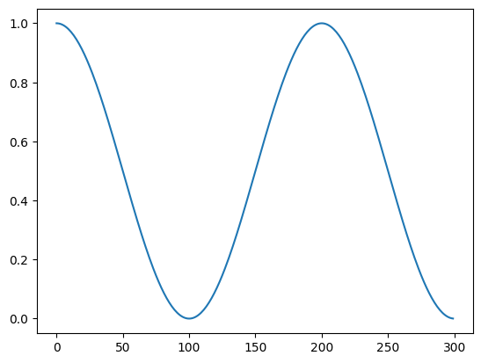
Cosine annealing

Slide 19

Results and Discussions
The model architecture is trained and tested on the following XOR Arbiter PUF
configurations:
2-XOR 32 bit
3-XOR 32 bit
4-XOR 32 bit
2-XOR 64 bit
32 bit configuration have $2^{32}$=4,294,967,296
64 bit configuration have $2^{64}$=18,446,744,073,709,551,616

Slide 20
32 bit configuration training
Learning rate of 0.005
Dropout 0.1

Slide 21
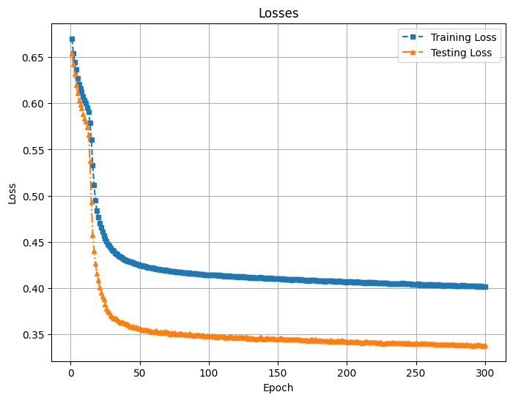
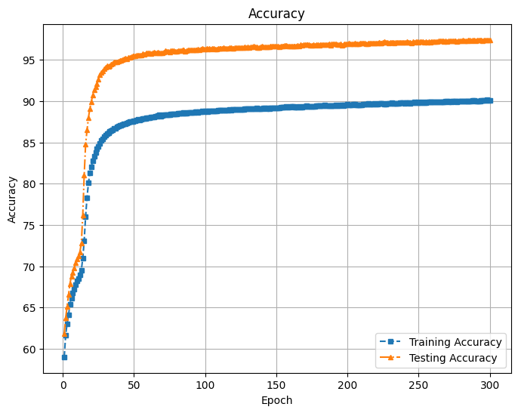
2-XOR 32 bit
1M training data are used for training, 0.02% of total combinations
1M testing data
Final test loss of 0.34
Final accuracy of 97.40%
90% accuracy as early as epoch 20

Slide 22
2-XOR 32 bit
 | True Pos | False Pos | True Neg | False Neg | Accuracy
1M | 522542 | 14021 | 451949 | 11488 | 97.45%
10M | 5226319 | 143074 | 4513968 | 116638 | 97.40%
20M | 10447993 | 284658 | 9033825 | 233523 | 97.41%
 | Precision | Recall | F1 Score
1M | 0.97387 | 0.97849 | 0.97617
10M | 0.97335 | 0.97817 | 0.97576
20M | 0.97348 | 0.97814 | 0.9758

Slide 23
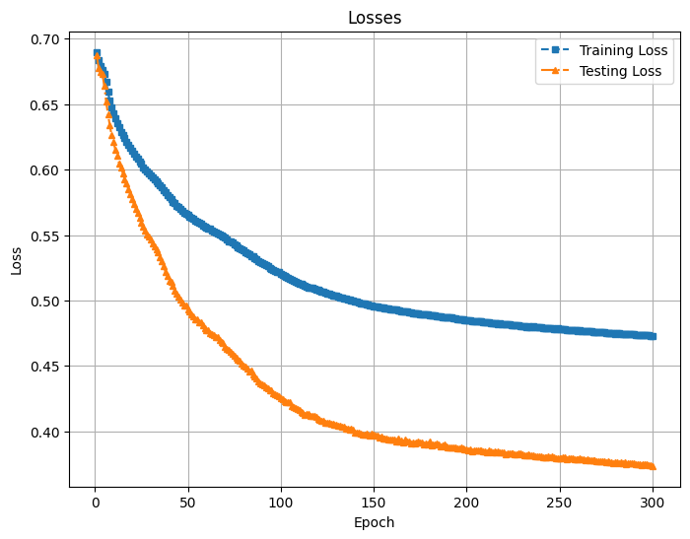
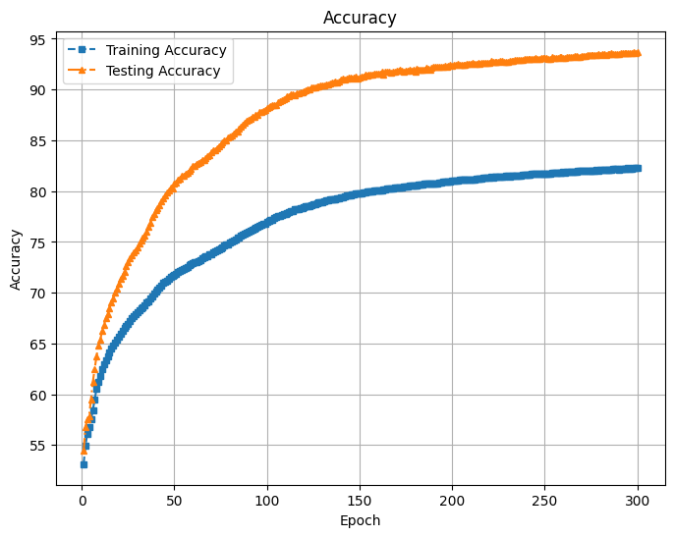
3-XOR 32 bit
4M training data are used for training,0.093% of total combinations
1M testing data
Final test loss of 0.37
Final accuracy of 93.40%
90% accuracy at epoch 120

Slide 24
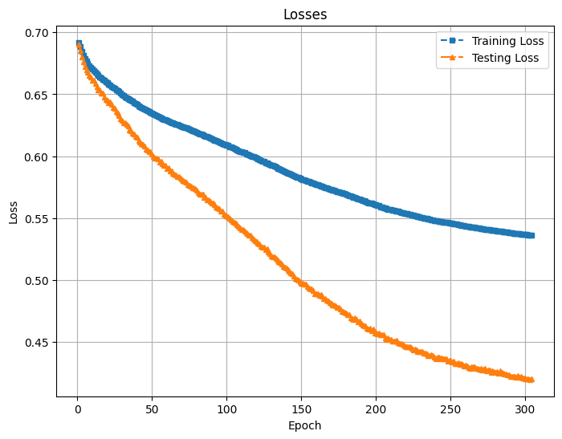
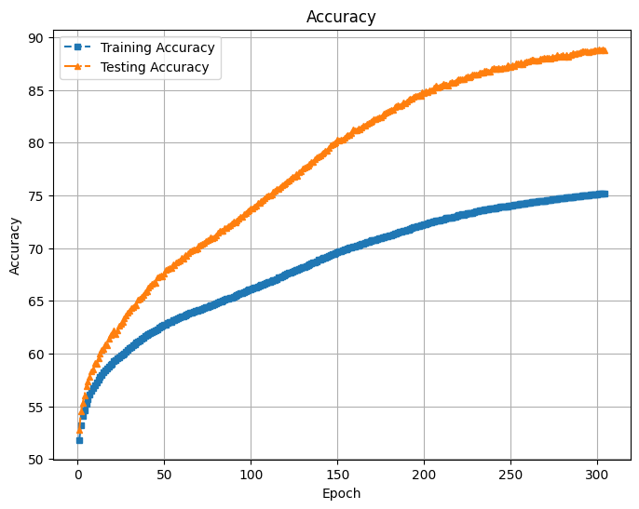
4-XOR 32 bit
4M training data are used for training,0.093% of total combinations
1M testing data
Final test loss of 0.42
Final accuracy of 88.88%

Slide 25
3-XOR 32 bit and 4-XOR 32 bit
 | True Pos | False Pos | True Neg | False Neg | Accuracy
3-XOR | 9225999 | 772098 | 9227169 | 774732 | 93.69%
4-XOR | 8641507 | 1111839 | 9110679 | 1135974 | 88.66%
 | Precision | Recall | F1 Score
3-XOR | 0.93642 | 0.93698 | 0.9367
4-XOR | 0.8860 | 0.88382 | 0.88491

Slide 26
64 bit configuration training
Learning rate of 0.001
Dropout 0.2

Slide 27
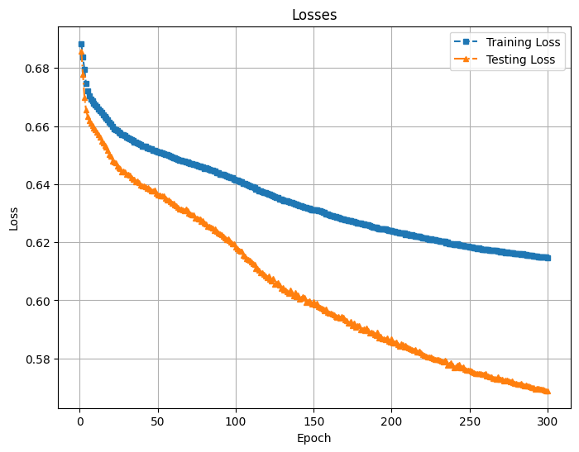
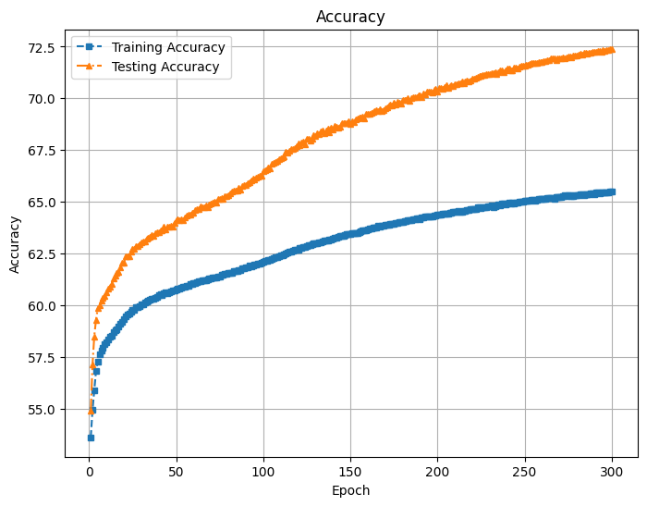
2-XOR 64 bit 4M training dataset
4M training data are used for training,2.6x10^-11% of total combinations
1M testing data
Final test loss of 0.57
Final accuracy of 72.40%

Slide 28
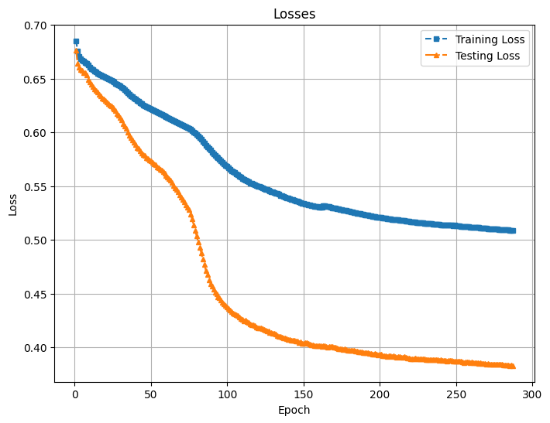
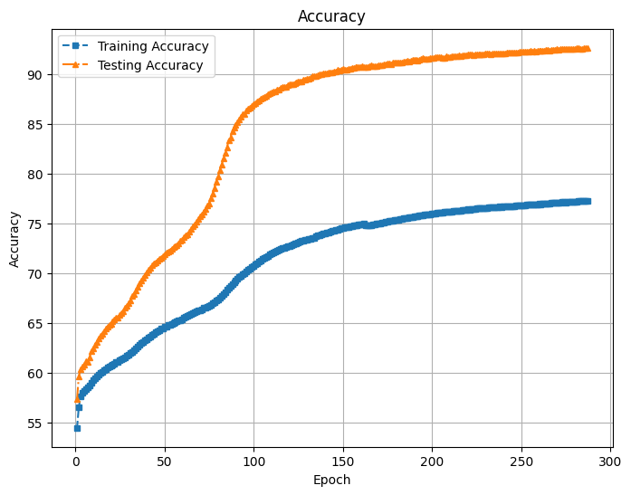
2-XOR 64 bit 9M training dataset
9M training data are used for training,4.87x10^-11% of total combinations
1M testing data
Final test loss of 0.38
Final test accuracy of 92.65%

Slide 29
2-XOR 64 bit with 4M and 9M dataset
 | True Pos | False Pos | True Neg | False Neg | Accuracy
4M | 7057998 | 2558606 | 7428426 | 2954969 | 72.43%
9M | 9248380 | 703938 | 9283879 | 763802 | 92.66%
 | Precision | Recall | F1 Score
4M | 0.73394 | 0.70489 | 0.71912
9M | 0.929278 | 0.92371 | 0.92648

Slide 30
Conclusion
The designed network was tested on 2-XOR, 3-XOR, 4-XOR 32 bit configurations and gave satisfactory performance at 1M training datasets for 2-XOR and 4M for 3-XOR and 4-XOR. It has 97.50% accuracy for 2-XOR 32 bit and 93.40% and 88.80% for 3-XOR and 4-XOR 32 bit respectively.
When tested on a 2-XOR 64 bit configuration, 9M datasets are required to have satisfactory performance. It was able to reach 92% accuracy at the end of 300 epochs.
This network could still be tested to other PUF configurations

